Slide 1
EPLUS DISTRIBUTED DATABASE MANAGEMENT SYSTEM

Slide 2
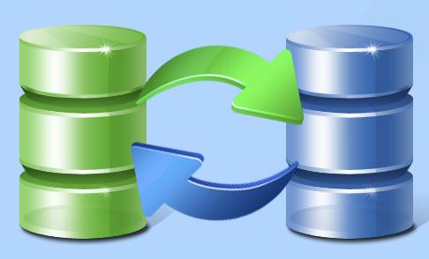
This system is replicating data from a database in one system to a database of another system, so all users can share same level of information. This method is replication.

Slide 3

Uses:
Can connect multiple servers through network
High speed internet is not needed

Slide 4




Working:
Main server
Network
Branch server
Branch server
Branch server

Slide 5
Advantages:
High speed internet is not needed,512 kbps is enough to synch
Each branch have their own database
True copy of the database will be available in the HO
Need to create items or account groups in HO only. It will synch into branches.
Reports of all branches will be available together or individually in HO

Slide 6
THANK YOU

